Slide 1



SOFTWARE PARADIGMS
Scrum: Theory and Practice
Vispi Shroff
Sub Heading
And Date

Slide 2

What’s in a Name?
Not an acronym
Based on a practice within the methodology which the co-creators thought was representative of a Scrum.
Co-created by Jeff Sutherland and Ken Schwaber, but term and many ideas originally credit to (Takeushi & Nonaka, 1986)
Scrum Principles from the Agile Manifesto
- Individuals and interactions over processes and tools
- Completed functionality over comprehensive documentation
- Customer collaboration over contract negotiation
- Responding to change over following a plan

Slide 3
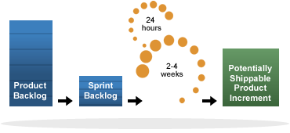
Scrum at a Glance

Slide 4
The roles people play
Product Owner: In charge of the project deliverables, product decisions, backlog ownership.
Scrum Master: Ensures the team functions cohesively and productively. The Scrum Master is the facilitator and the ‘obstacle remover’ for the Scrum Team.
Scrum Team: Self-organised and self-directed work team. It important to have an experienced developers in a Scrum Team.

Slide 5
Important Scrum Activities
Sprint Planning: Decide what is to be done in this sprint, with the Product Owner
Daily Scrum Meeting: A daily stand-up meeting where the team’s progress is mapped, difficulties are shared, etc. Should be short.
Sprint Review: Go through the items completed in the Sprint with the Product Owner
Sprint Retrospective: Review how to improve the product and the processes being used

Slide 6
Scrum Artefacts
Product Backlog: Prioritised list of all the functionality which the client desired to be implemented. Higher priority functionality is more finely defined.
Sprint Backlog: Set of work from the product backlog which the team agrees to complete for a given sprint.
Burndown Charts: Progress charts of work completed over the duration of a sprint, a easy visual indication of progress made over the sprint.

Slide 7
A Scrum Implementation
The Official Line
Background of the company
Problems being faced at the time of Scrum implementation
Growing troubles
No change management
Spaghetti Code
Adding a new features of was introducing 3-5 issues with existing features.
No idea of what we could/would deliver or when we would be able to deliver it.

Slide 8
The 1st Sprint – Aug 2006
A bug fixing sprint, team of 3 developers and 1 QA person
Estimated time: 1 month
Delivery time: 2 months
Problems included broken builds, bugs marked as fixed not actually fixed, a very time consuming build process.
Lessons learnt and processes implemented included code reviews by fellow developers, developer testing and a requirement for an shortened and automated build process.

Slide 9
Over subsequent sprints
Continued to deliver late, but the % of delay kept reducing.
Our sprints varied in duration from 2 months to 4 months.
At its height, team comprised of 6 developers and 2 QA people.
Product was slowly but steadily re-designed.
Different Scrum Masters & Product Owners
CTO left the company, other organisational problems
The stand-up meetings weren’t stand-up, and team tensions were beginning to spill over in the meetings
All employees were made redundant in June 2007 and operations were shut down.

Slide 10
A new chance – October 2007
Company was reformed three months later, only 3 of the original 9 employees returned.
Lessons were learnt from previous sprints.
We hired people with many years of industry experience.
Moved away from daily stand-up meetings to individual schedules managed on a daily basis.
We did fixed length sprints of 2 months.
All the sprints were on time and had the functionality that the team had agreed on.

Slide 11
Key Learning Lessons
You need experienced developers on your team
The more detailed the estimate, the better
You rarely get 8 hours of productivity on any given day
Just as with any business, other external factors can have significant impacts on the development efforts of the team.

Slide 12
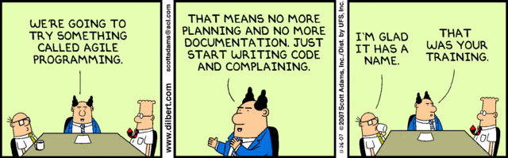
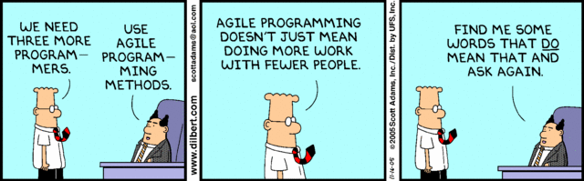
Any Thoughts, Questions, Ideas?

Slide 13
References
Takeuchi, H. and I. Nonaka, 1986 - The New New Product Development Game. Harvard Business Review, 1986(January-February).
scrumalliance.org, 2010. Scrum Alliance - What Is Scrum? Available at: http://www.scrumalliance.org/pages/what_is_scrum [Accessed September 24, 2010].
Dilbert Comics, 2010.

